Slide 2
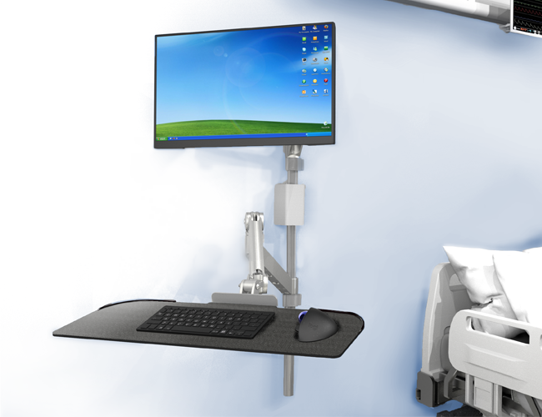
PACE Pole Wall Mount Workstation
Advances the look of the exam room by replacing the wall track with the Grand Stands wall clamp and stainless-steel pole. Our One-way friction lock mechanism provides extended height range, focal depth, and a more stable keyboard support.
Features
Ease of use - Technician can face the patient
Focal distance extension - 23.6”
Monitor arm height range -15”
Cable management clips hide the cables down the back of the pole
36” Stainless-steel pole is adjustable within the wall clamp
CPU or thin client mount available
One-way friction lock technology will not drop while typing
10-year warranty
Silver
Monitor Arm System

Slide 3
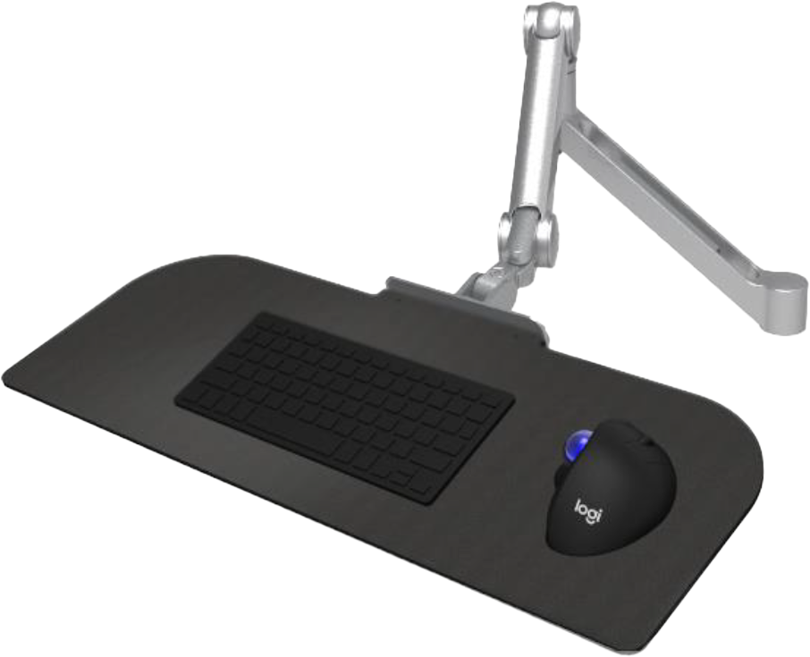
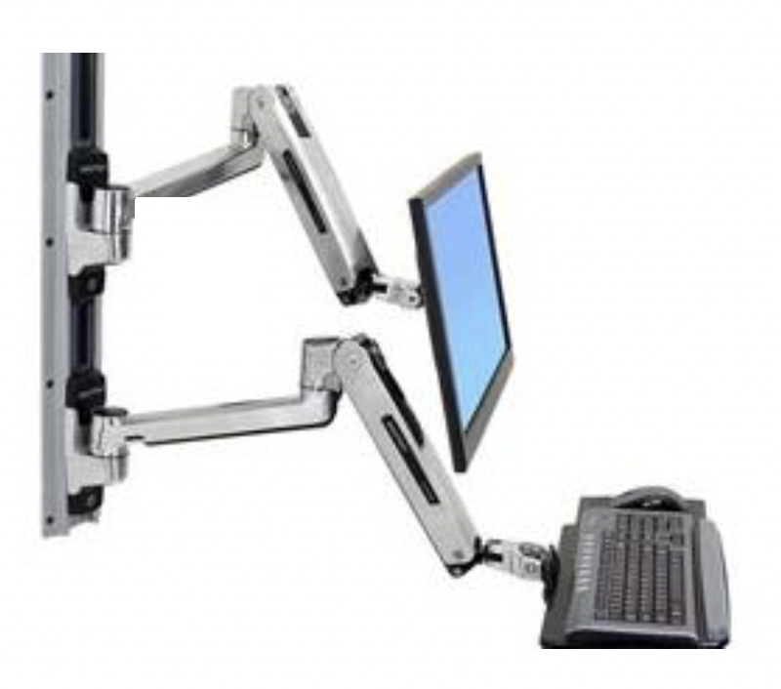
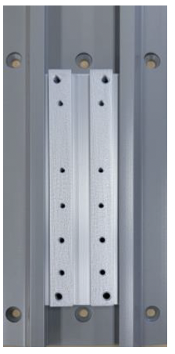
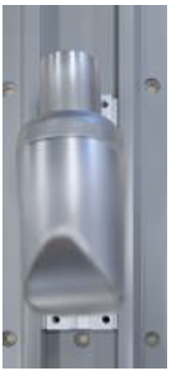
Solution
ACE15 Keyboard with One-way friction lock technology will support the weight of the hands and force of typing. – WILL NOT DROP
ACE15 Keyboard Retrofit
Solves the problem of existing wall systems that have keyboard trays that drop while typing.
Existing wall mounted keyboard supports are counterbalanced and will not support the weight of the hands and force of typing. The platform holding the keyboard will drop in use.
The Grand Stands conversion bracket will retrofit directly into the existing wall sled. The ACE15 Retrofit is a quick installation - 4 screws to remove the existing arm mount and 4 screws to install the new ACE15 retrofit bracket for monitor or keyboard arm.
Existing wall sled and arm mount, attached with 4 screws
Ergotron mounting sled showing hole pattern
Grand Stands ACE15 retrofit bracket mates to the existing hole pattern
3

Slide 4
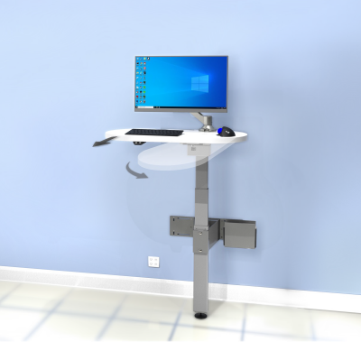
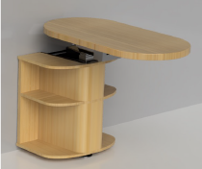
L3 MedWall
Brings sit-stand technology to the exam room. Allows for the surface to store against the wall and swivels 90 degrees so the doctor or technician can face the patient with a minimal footprint.
Features
25.5” of height adjustment, 22.5” to 48” from the floor.
“S2” bracket has 5.5” front to back slide and 90-degree swivel to go from facing the wall to facing the patient.
15” x 30” standard platform
Standard up/down switch
Impact detection
10-year warranty
Options
Monitor arm and CPU holder available
Digital display memory switch
Custom sizes
Fixed top mount
Laminate shelves and case
Wall strut option for easy installation
OSHPO/HCAI option
Also available height adjustable Microscope Stand
Shown with optional ACE15 Monitor Arm & CPU holder.
L3 MedWall with optional
laminate shelves

Slide 5
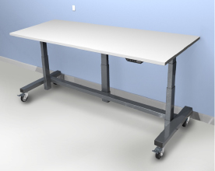
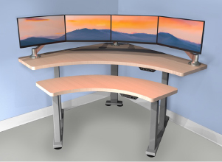
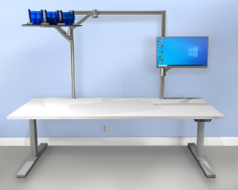
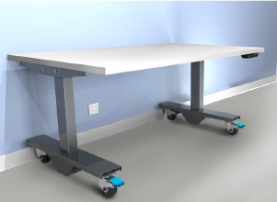
Healthcare Sit-Stand Tables
For radiology, telemetry, and process applications. Grand Stands Medical has standard offerings and custom capabilities.
Features
Standard lift capacity from (2 Leg) 350 lbs. to (4 Leg) 700 lbs.
Impact detection
Digital display memory switch
Options
Bi-level
2-5 leg systems
Industrial duty casters
20“ (2-stage) or 25.5“ (3-stage) height ranges
Custom surfaces (HPL, stainless-steel, phenolic)
Custom base frames
Heavy duty lift capacity, up to (4 Leg) 1000 lbs.
Multiple monitor support solutions
Toolbar and accessories

Slide 6
Multi-Purpose ACE15 Support Arm
6

Slide 7
ACE15 Support Arm for Labs and Industrial

Slide 8
Why Grand Stands
Extensive Customization Capabilities
Grand Stands Healthcare sets the gold standard for custom solutions, swiftly engineered and fabricated right in our Southern California HQ. Whether you need a custom bracket to augment an existing piece of equipment or a modified off-the-shelf product to address a specific application, the Grand Stands Healthcare team cuts through complexity, builds a spec and crafts your unique solution in a matter of days or weeks—not months.
No other company provides this level of customization, speed, and flexibility in finding you a solution.
Exceptional Pre and Post Sales Support
We listen to the needs of our clients to find proper solutions and implement our process strategy.
Grand Stands Healthcare will be on every project call necessary to ensure we deliver on time and on budget. We are available to be on-site for the installation to ensure excellence in our solutions.
Lower long-term cost of ownership of Grand Stands Healthcare solutions means we will be there long after the initial installation to support our products.

Slide 9
Grand Stands Innovation Found at These Esteemed Institutions
Serving over 20,000 Satisfied Customers Since 1991

Slide 10
Thank you for getting to know us!

